Slide 1

Online Consumerism

Slide 2
Hypothesis
How are people spending money online?
Notes:
We are looking at a few factors within a dataset to determine if there is a correlation to how people are willing to spend their money online.
How do the online spending habits differ between men and women based on location and product type?

Slide 3
Data cleaning
Initially dropped two columns that didn't seem to add anything to the data
Checked for null values and dropped them
Combined three locations to make a north-east region to better analyze the data
Combined the “Nest” categories to simplify analysis
Changing the date column to datetime
Notes:
Dropping data: At first looking at the data we decided that two columns (unnamed:0 and the Product SKU) didn't add anything to the data that we needed, so we used .drop to drop the columns and make a new data frame without them.
Then we checked for any null values that we needed to get rid of and dropped them using the .dropna
Combining the locations: out initial data had five locations, upon looking at the data we decided to combine the three locations that were relatively close to each other to make a region with a similar number of data points as the other two locations. We used .replace to combine new york, new jersey, and washington dc to make the northeast region.
We also noticed that the product category had three different nest categories so we decided to combine those as well to have a more accurate representation of that category
We also changed the date column into a datetime dtype and reformatted the date to be month/day/year

Slide 4
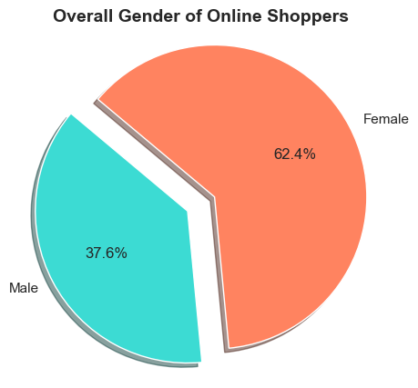
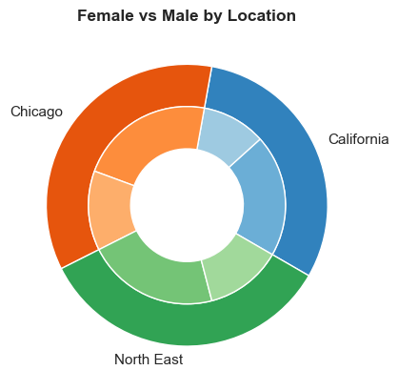
Who makes up the majority of the market? Who is spending more, and what are they purchasing?

Slide 5
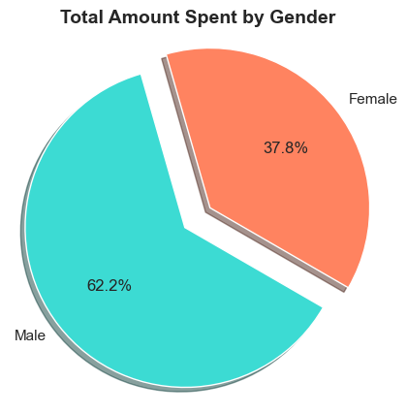
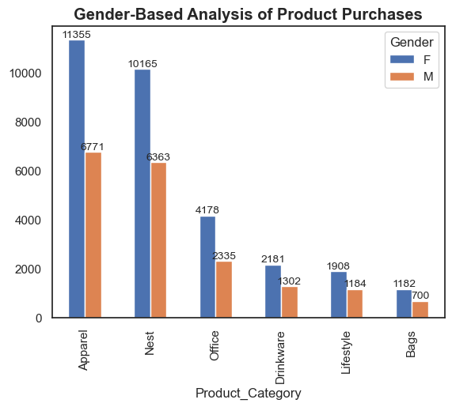

Slide 6
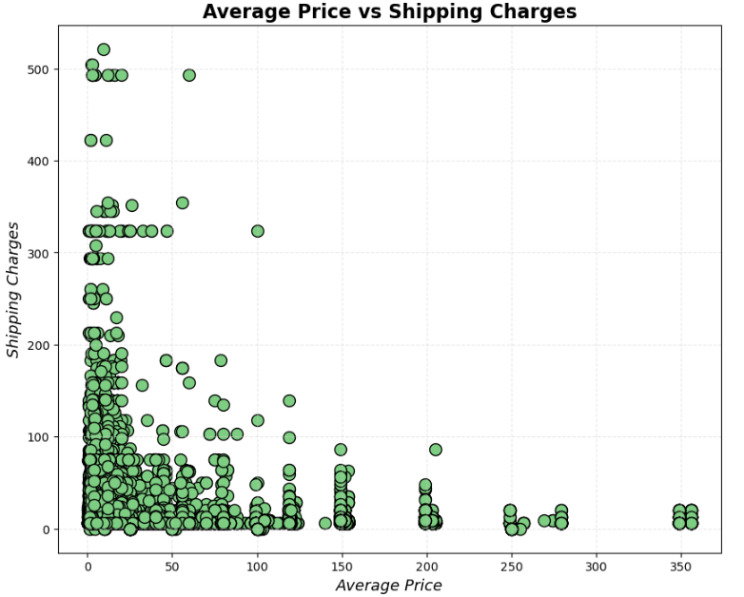
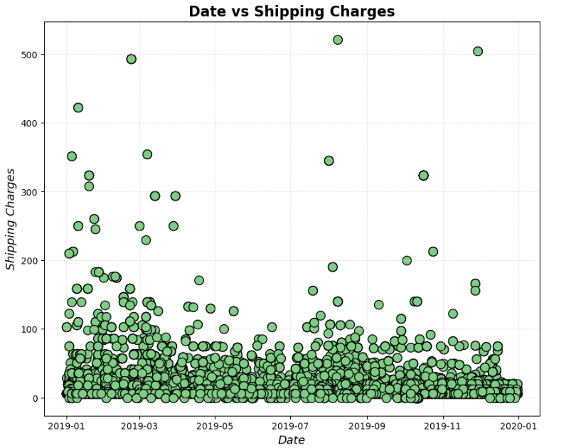
Question: Is there a relationship between cost of an item and the delivery charges? Date and shipping?
The average price of the item and its impact on the cost of delivery people are willing to spend.
The time of year and the impact it has on the cost of delivery people are willing to spend.
Notes:
On the left we are looking at if the price of the item verses the shipping charge. Is there a correlation? This data really shows a ton of outliers that don’t seem to make sense. Someone paying more for shipping than an item costs. The data was merged from three different sources and could have had problems merging properly. Maybe some columns were reversed. It is hard to tell. Maybe these are real datapoints because of a freight charge on an item. Maybe something was heavily discounted. Maybe some people have too much money on their hands.

Slide 7
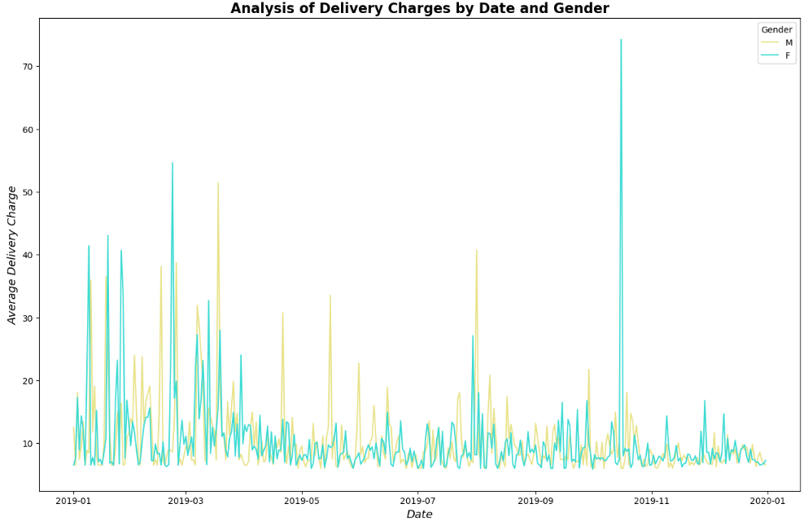
Additionally: Are the delivery charge outliers explained by a certain time of year between gender?
Notes:
The previous graphs had me curious if any of the differences exist between the genders and the time of year these shipping charges are occurring. There may be an explanation of the outliers. October sees a huge increase in women being willing to spend money on delivery charges. Are they getting the perfect halloween outfit? Men tend to spend more in the summer months. Last minute anniversary gift? Do these make sense. I am not sure the extreme outliers are really explained given any of the visualizations so far.

Slide 8
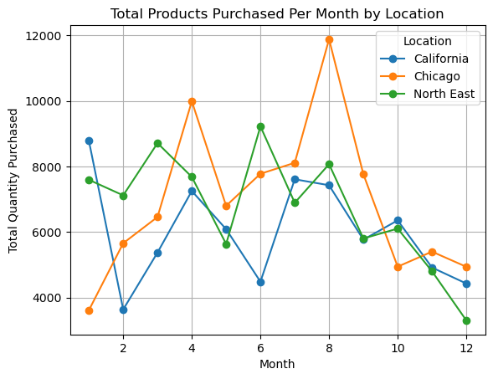
Hypothesis and Visualization
Question- does location influence purchase frequency?
My hypothesis- I hypothesize that California will surpass the Northeast due to its large population and high propensity for e-commerce transactions.
Answer- Looking at my dataset my hypothesis was incorrect. Who would’ve guessed?
Points to talk about here
This data visualization represents online purchase trends from the year 2019.

Slide 9
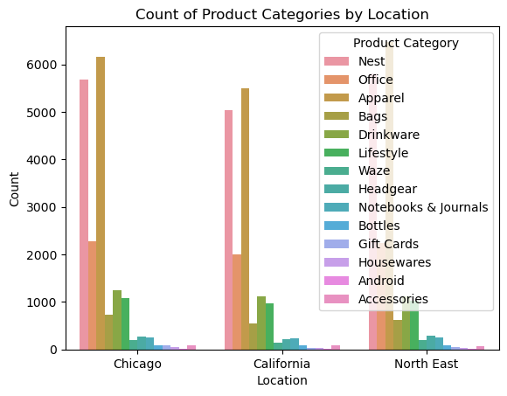
The data reveals a clear trend where apparel sales consistently are purchased more than any other product purchased.
Smart home devices follow closely after.
Finally, the higher purchase of office supplies in Chicago than California may indicate a greater level of business activity or office demand in Chicago.

Slide 10
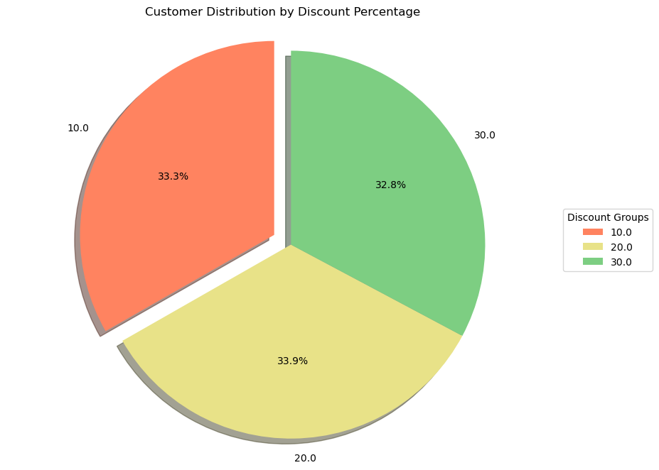
Hypothesis and Visualization
Question- How do different discount purchases affect the number of repeat customers compared to other discount levels?
My hypothesis- My hypothesis is that the an increase in discount percentage will lead to higher number of customers making purchases.
Answer- My hypothesis was incorrect; customer purchases remained fairly consistent regardless of the discount percentage. Therefore, I believe that customers are more focused on the product itself rather than the discount offered.
Points to talk about here
This data visualization represents discount purchase trends from the year 2019.

Slide 11
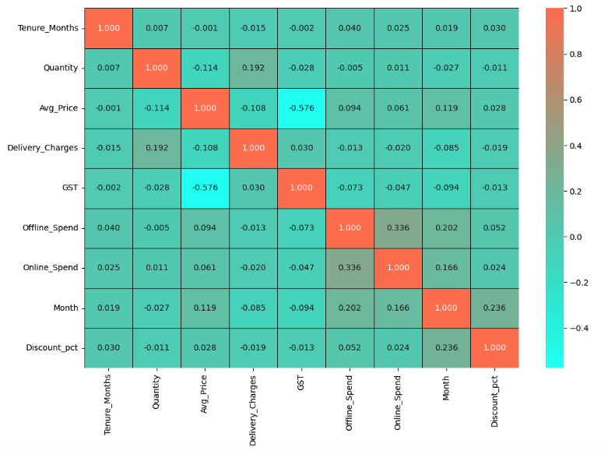
Offline and online spend are the most correlated
The GST and the average price are the least correlated
Notes:
Looking at this heatmap to get a feel of what kinds of possible relationships there are between our different categories.
The GST or goods and services tax associated with the product and the average price of the product are the least correlated values in the heatmap, this could be because different products might have different countries of origin and different tax rates. There are no values in the data that appear to be significantly correlated, but, the most correlated values are the offline and online spending, with about a 34% correlation. But after looking more into the data its hard to know if the is really a significant relationship because we are unsure how the offline spending data was gathered when this dataset is based on online data.

Slide 12
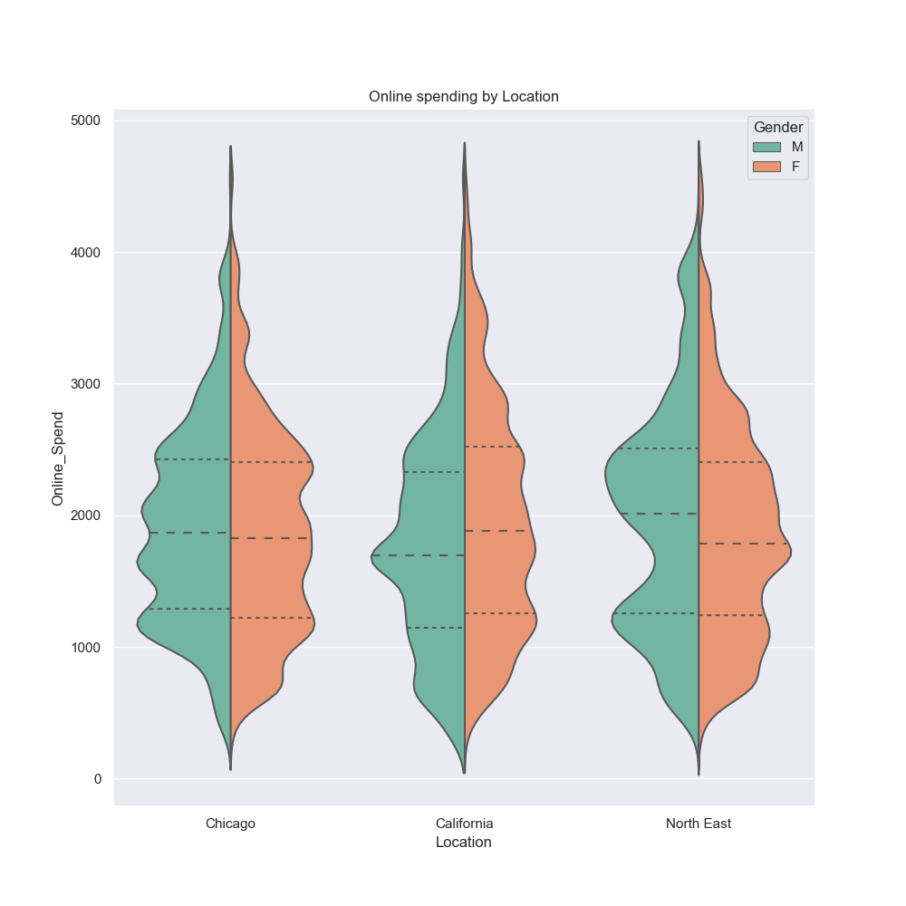
In Chicago men and women have similar online spending habits
Notes:
Overall these violin plots are showing the relationships between how men and women are spending their money online based on their region.
Its interesting to see some of the highs and lows in the distribution of the plots especially how in california many of the men are spending the average while in the northeast more women are spending about the average

Slide 13
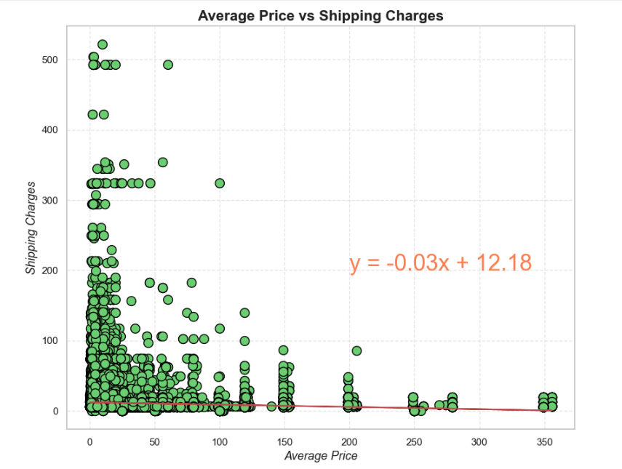
The r-squared value is 0.011
1% of the data considered to be significant
Notes:
The r-squared is: 0.011669530024367334
With the r2 it only explains about 1% of our data, because only about one percent of the data is correlated or significant there isnt a strong correlation between the average price of the item and the associated shipping charged. There are some interesting outliers on the plot, several items are close to 0 for the average purchase price but have shipping charges close to 500 dollars.

Slide 14
Call to action Bias limitations
Given the lack of correlations so far, more research is required to determine how people are spending their money online.
The data has unknown origins
Needs more locations to draw more meaningful insights from the data
Notes:
Call to action:
Because of the lack of correlation to be able to draw any meaningful conclusions from the data we would need data from other sources tro try and prove/disprove some of our theories on the data.
Bias limitations:
The data comes from several different kaggle datasets making it hard to verify the validity of the data.
Because of this there are several things we came across that raised some red flags like several date columns and an offline spend column.
These limitations make it hard for us to have a solid call to action.
This data only didn't have very many locations, and of the locations that it did have it wasn't consistent, we had states and cities, this makes it hard to really compare location spending.

Slide 15
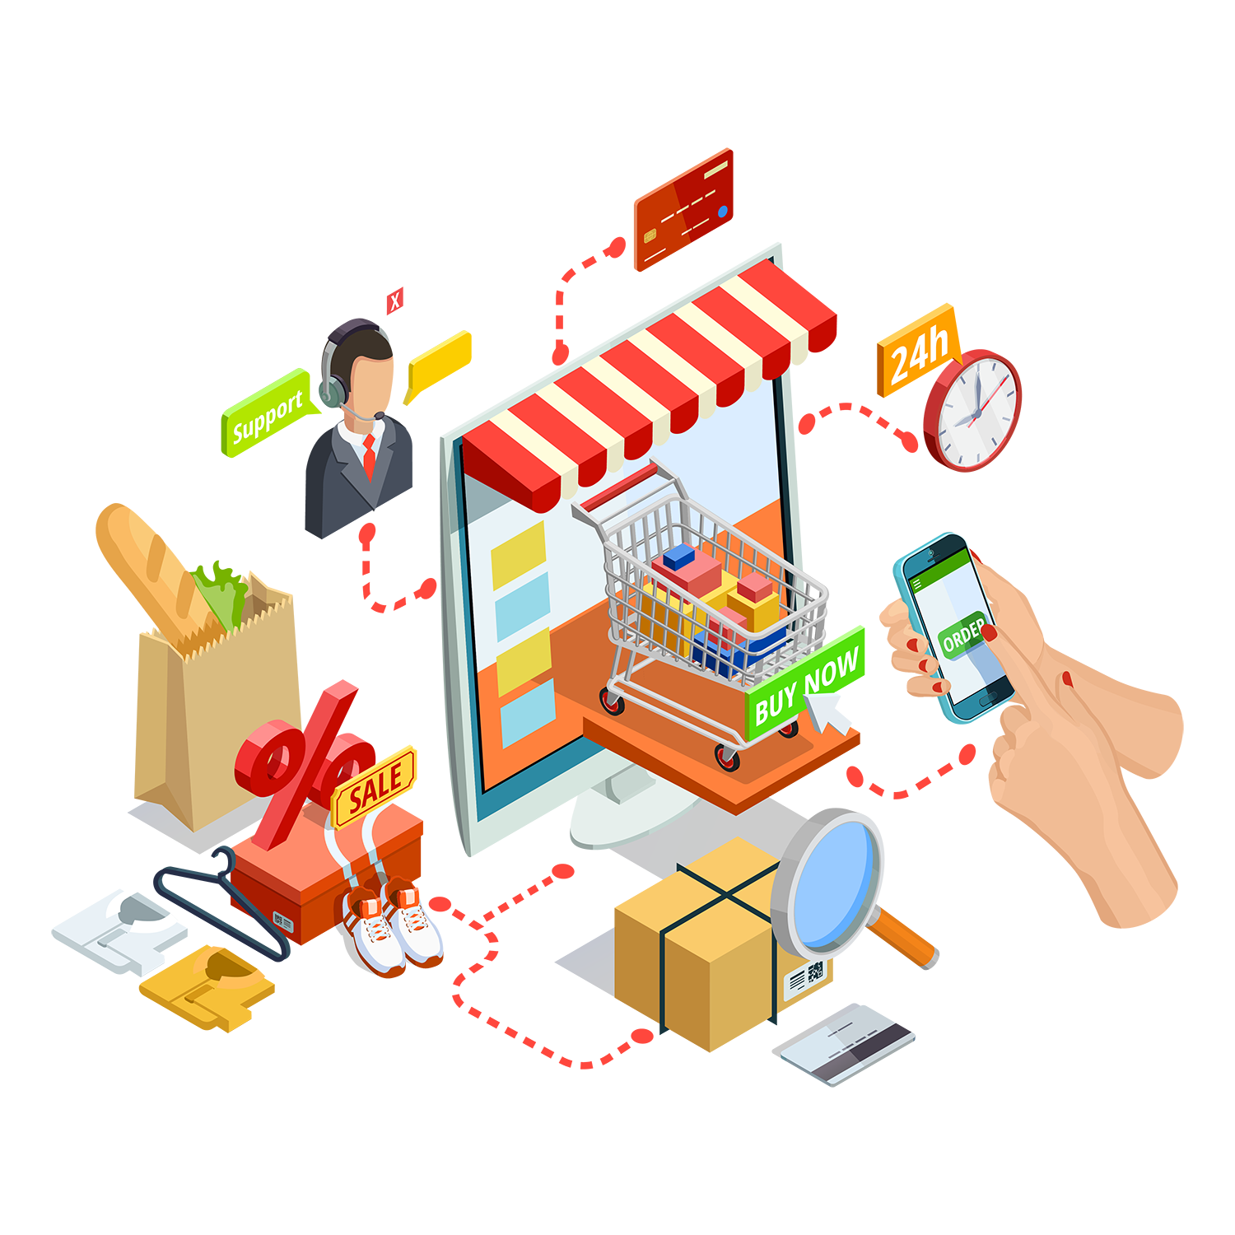
Future work
Compare pre pandemic, pandemic, and post pandemic data to see if tends have changed
Use the data to identify trends to better market products
Notes:
There is alot of opportunity for future work for the topic in general, but maybe not with this dataset
All of our data came from 2019, it would be interesting to look at data from the years during the pandemic and post pandemic to see how the average consumer online shopping habits have changed.
Using this data you can also better identify online shopping trends and who you should be targeting based on your product.

Slide 16
Works Cited
https://www.kaggle.com/datasets/jacksondivakarr/online-shopping-dataset

Slide 17


Questions?

